Slide 1


Security, week 4
Kasper Østerbye

Slide 2
Encrypting your information
Is like putting your valuables in a safe.
It is a second layer in case your house is broken into.

Slide 3
What is personal data?
Personal data is any information that relates to an identified or identifiable living individual.
For example:
a name and surname;
a home address;
an email address such as name.surname@company.com;
an identification card number;
location data (for example the location data function on a mobile phone)*;
an Internet Protocol (IP) address;
a cookie ID*;
the advertising identifier of your phone;
data held by a hospital or doctor, which could be a symbol that uniquely identifies a person.

Slide 4
Data controller
The data controller determines the purposes for which and the means by which personal data is processed.
So, if your company/organisation decides ‘why’ and ‘how’ the personal data should be processed it is the data controller.

Slide 5
Data processor
The data processor processes personal data only on behalf of the controller. The data processor is usually a third party external to the company.
E.g. A payroll company, many IT service companies

Slide 6
Exercise
Which personal information do chpbusiness control?
Which personal information do we process?

Slide 7
Base64 encoding
Often we need to store binary information as characters (e.g. emails with attachments)
Base64 encode/decode is one way to do this.
Java has support for this – look in exercise 1.

Slide 8
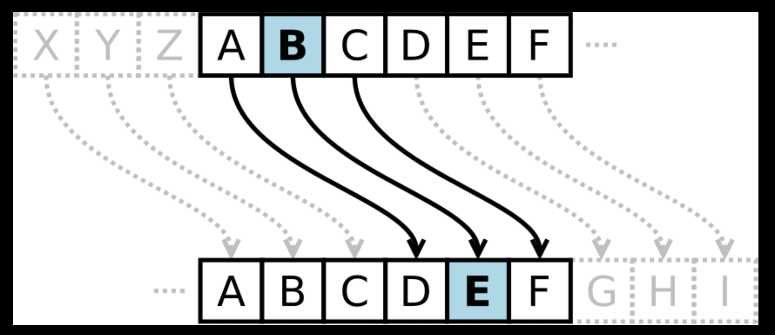
Cesar rot code
Such an old method it is not clear it was ever used.
Rot-3

Slide 9
Crack the code in exercise 1.

Slide 10
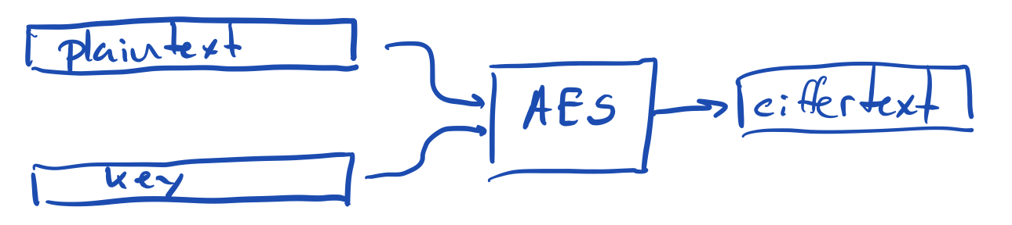
AES algorithm
The heart of the algorithm can “only” encrypt blocks which are 128, 196, or 256 bits long
(16, 24, or 32 bytes)
(( Long session and drawing on the whiteboard))
To make it work on real data, we need to
break the plain text into blocks and
encrypt each block. There is one stupid way, and many good ways to do this

Slide 11
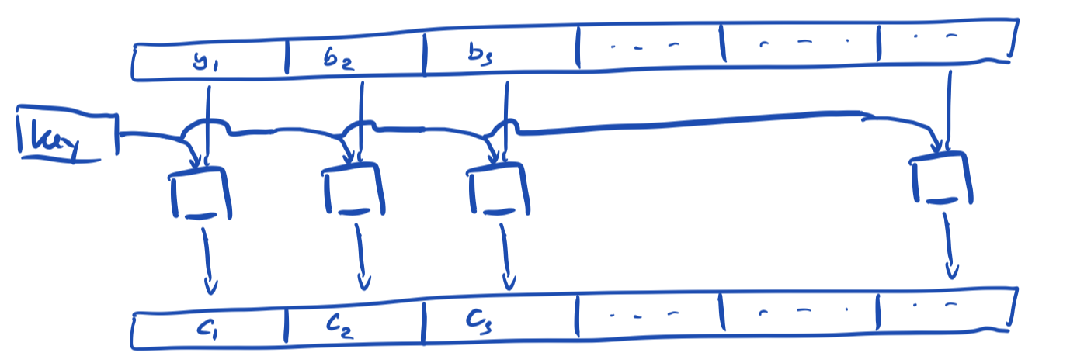
The stupid way - Electronic Codebook (ECB)
Do not encode each block using the same key

Slide 12
Cipher Block Chaining (CBC)
Bitwise
xor

Slide 13
Counter (CTR)
Secret & blockcount combined
using xor or other mechanism

Slide 14
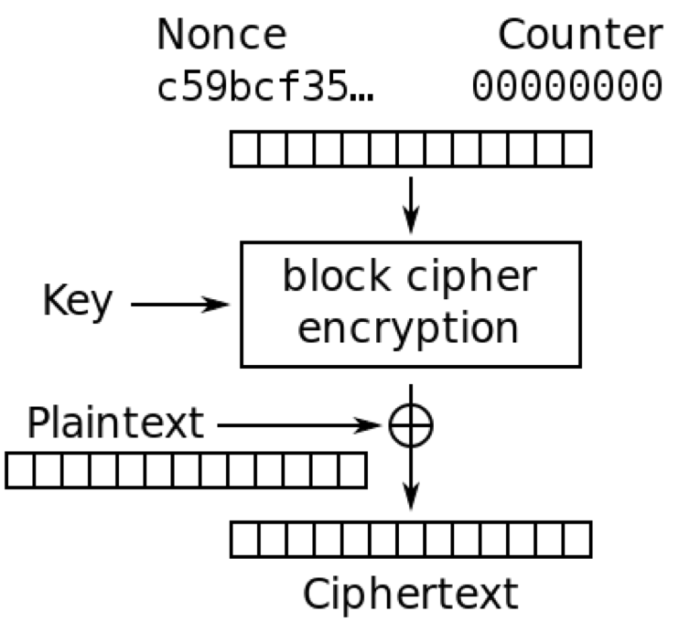
There are Java libraries for it all
And they are easy to use wrong.
There are three inputs
Plaintext
Key
Nonce (NumberOnce)

Slide 15
The Nonce
Is generated by a good random generator, saved to disk to be used later for decryption.
See sample code for this

Slide 16
The key
Has to be 128 (or 196 or 256) bits.
Is mostly generated from a password.
We will not go into password hashing now.
See the sample code for how to generate a 128 bit key from arbitrary password.

